Slide 1
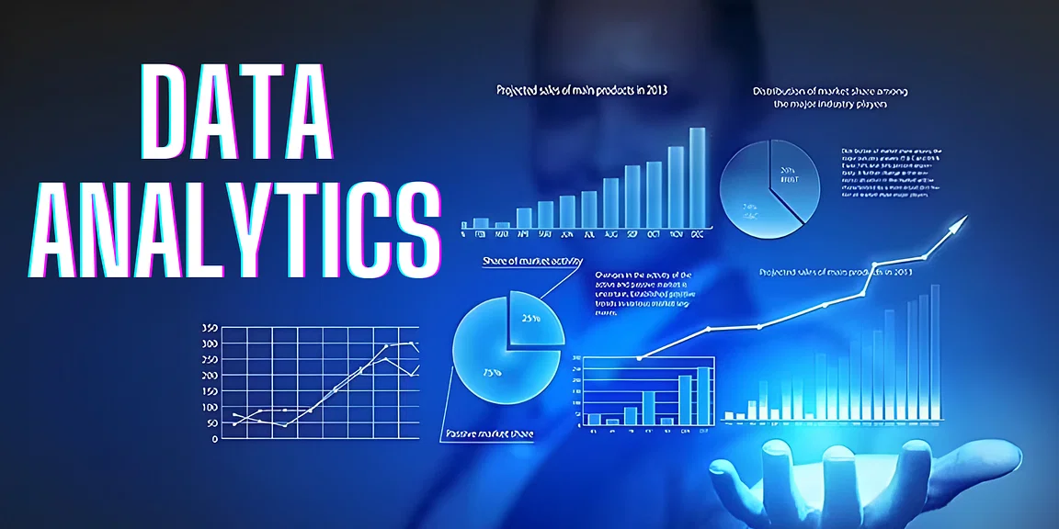

Slide 2
What is Data?
Data is a different types of information formatted in a particular manner or Data is a collection of information present in the form of History, Past records or Present records.
Data can come in the form of text, picture, numbers, graphs and symbols.
What is Data Analytics?
Data Analytics is the process of collection, transformation and organizing the data in order to draw conclusions, make predictions and to boost data driven decision making.

Slide 3
Applications of Data Analytics
Data Analytics is used in the banking and e-commerce industries to detect fraudulent transactions.
The Healthcare sectors uses data analytics to improve patients health by detecting diseases before they happen. It is commonly used for cancer detection.
Logistics companies use data analytics to ensure faster delivery of products by optimizing vehicle routes.
Marketing professionals use analytics to reach out to the right customers and perform targeted marketing to increase ROI.
Data analytics can be used for city planning, to build smart cities.

Slide 4
Facebook Data Analysis
Let me Explain how data analyst works in a real-world industry by taking example of Facebook Data Analysis Project.
Steps Followed in Data analysis Process
Problem statement
Data Collection
Data Cleaning
EDA process
Creating Graph
Conclusion

Slide 5
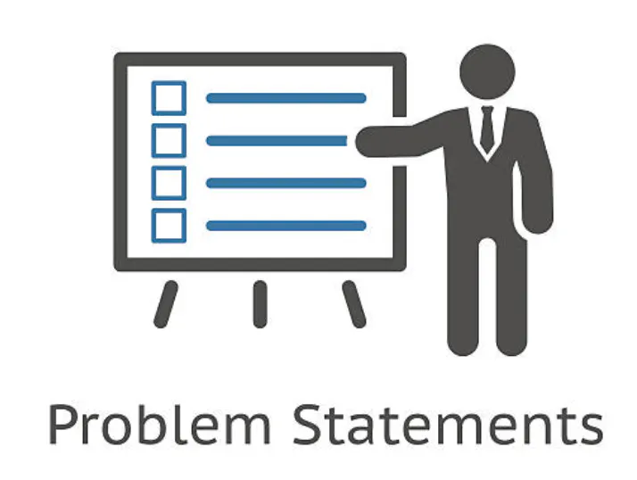
Step 1: Problem Statement
Find Number of male and female Facebook users, Likes received according to gender and count of users according to age.

Slide 6
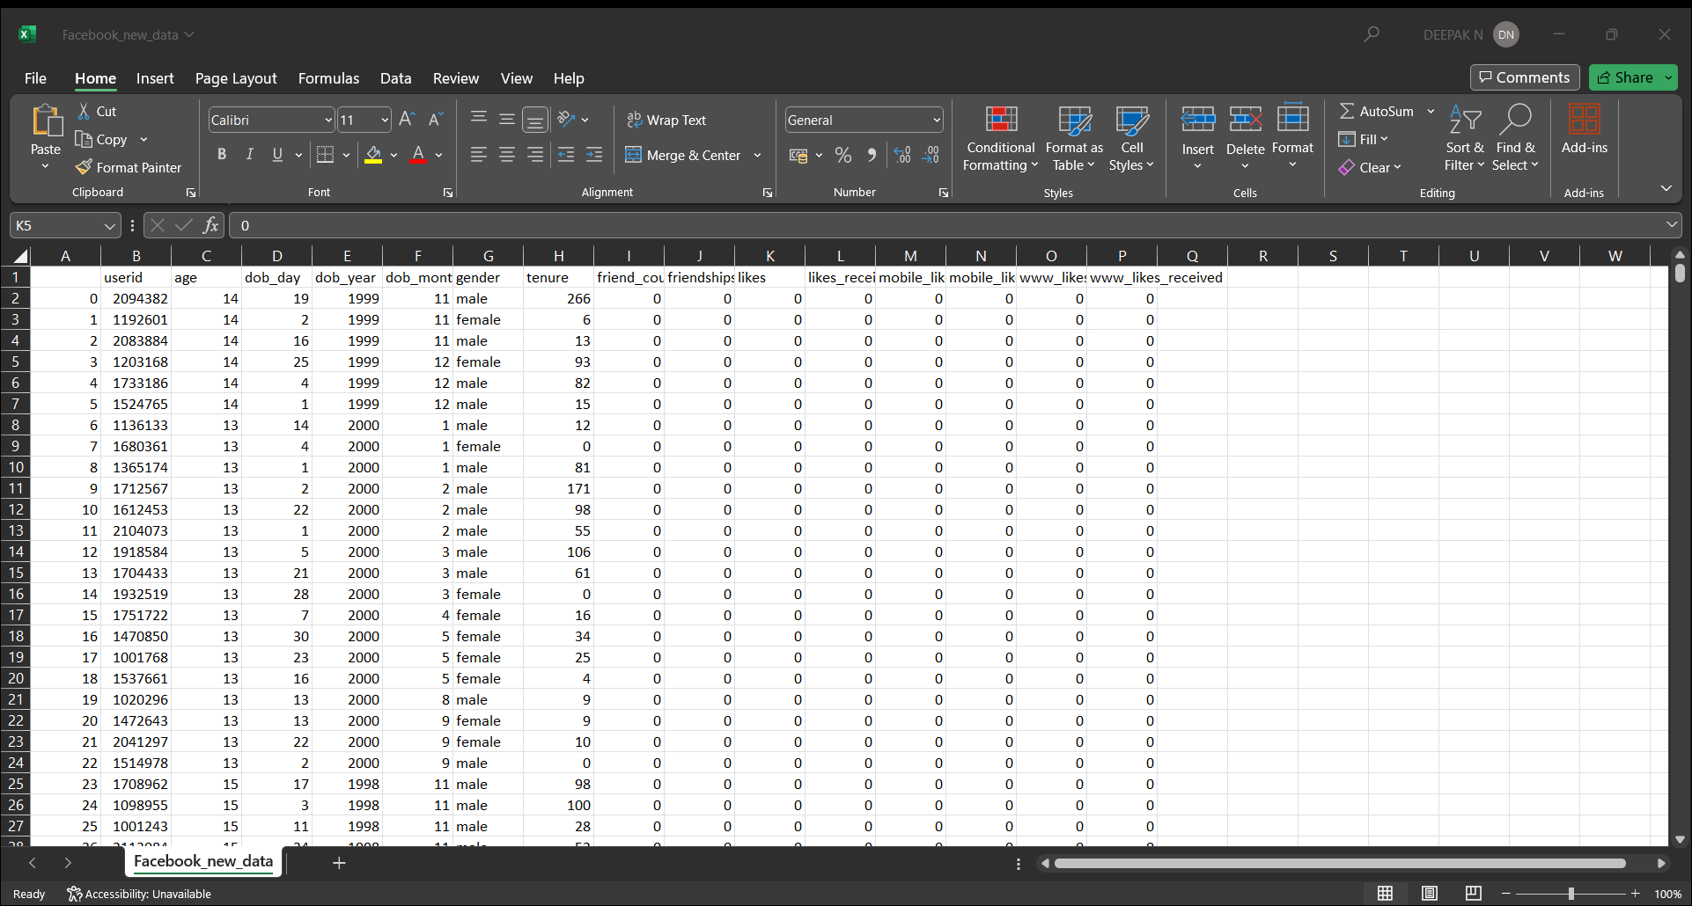
Step 2: Data Collection
Data Format: Facebook.csv
Data Size: 5.09 MB
Collection of measurements:
Total No. of Columns: 15
Total No. of Rows: 99,003
Column Names:
Numerical Data/Columns: userid, age, dob_day, dob_month, dob_year, tenure, friend_count, friendships_initiated, likes, likes_received, mobile_likes, mobile_likes_received, www_likes, www_likes_received.
Categorical Data/Columns: gender

Slide 7
Step 3: Data Cleaning
Data cleaning process is done by using ETL (Extract, Transform, Load) technique.
Extract: Extract the data from file in csv, sql format of file.
Transform: Transform is nothing but modify or change the data. In this step we clean all the data, to find missing values and filled them using python libraries. So new values are added to the existed raw data and to make it clean.
Load: Load or upload the cleaned data into database.
Data cleaning is done by using Python in Jupyter Notebook
By using pandas library we accessed the data / read the file using following code:
df = pd.read_csv v(‘facebook user data –facebook user data.csv’)
Here df is a variable in which data is stored to perform operations, pd refers to pandas.

Slide 8
Using df.info() we check total numbers of columns and rows present in our dataset.
In this Facebook data we have total 15 columns and 99003 rows in which 14 columns have numerical data and remaining 1 is categorical data.
Gender is the only column which have categorical data, In this column we have 175 rows of null values and in tenure column have 2 rows of null values.
We used Scikit-learn library to fill the missing values in the columns. Gender column containing only male & female so we used mode (most frequent) method to fill the null values. Considering tenure column, the null values are filled by using median method

Slide 9
Step 4: EDA ( Exploratory Data Analysis)
Here for graphical presentation and color combination we used matplotlib and seaborn libraries.
EDA technique is used to analyze cleaned data to draw informative insights.
So here we came to know that,
The percentage of male users are more and female users are less.
We also analyzed users according to age, most of the users belongs to 18 years, 19 years and 23 years age category.
Comparing male and female users, females received more likes compared to male users.

Slide 10
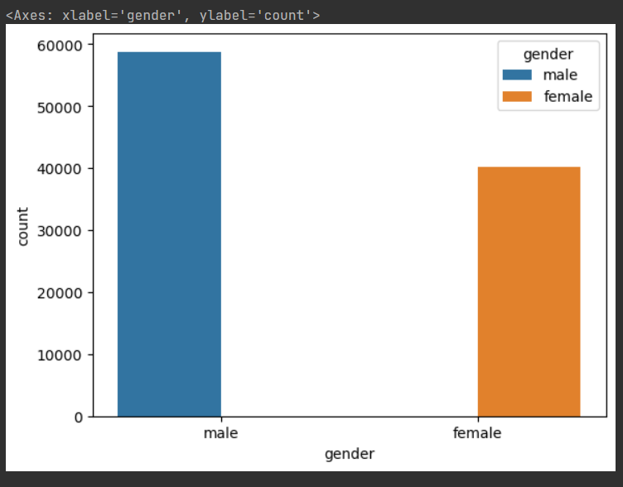
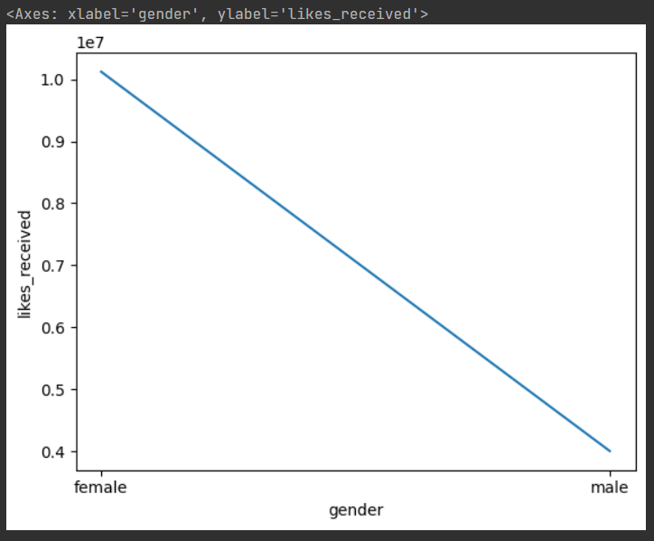
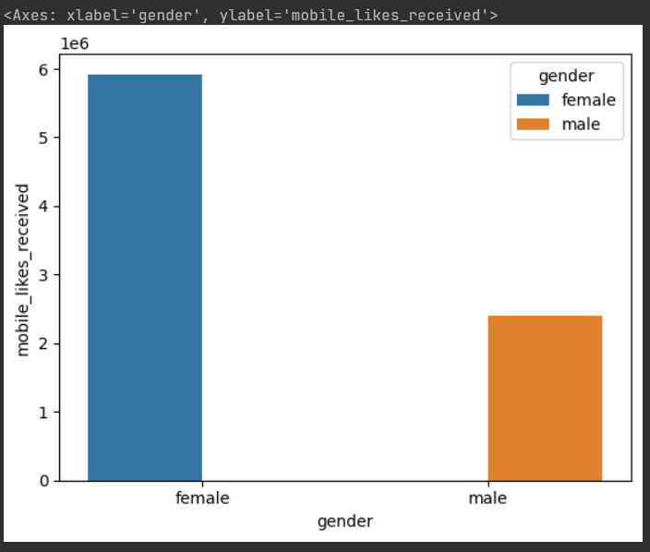
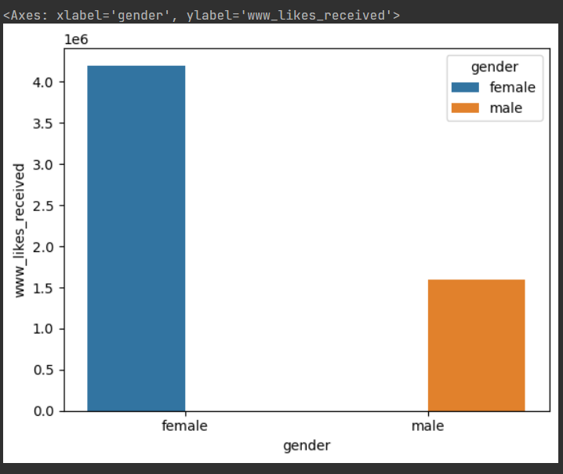
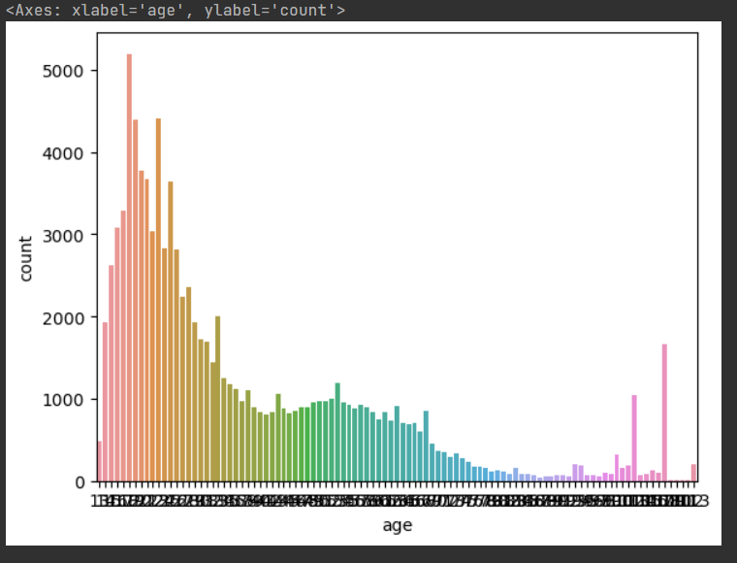
Step 5: Creating Graph
To create graph different types of charts are used in the Facebook data analysis creation.

Slide 11
Conclusion:
Facebook Data Analysis dashboard shows an overview of Facebook users. Number of male users are more compare to female users and female users are got more likes. According to age, the age group between 18-23 years old users are more in number.

